Slide 1
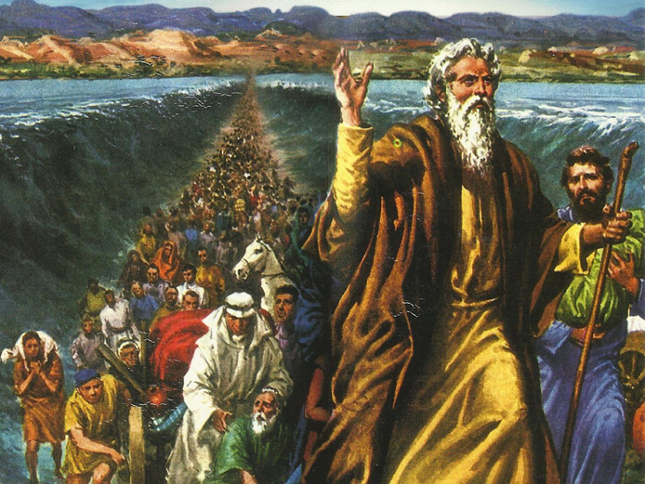
CATECHETICAL TEXTBOOK SERIES OF THE SYRO - MALABAR CHURCH
ON THE PATH OF SALVATION - 5
PEOPLE WHO AWAITED THE REDEEMER
5

Slide 2
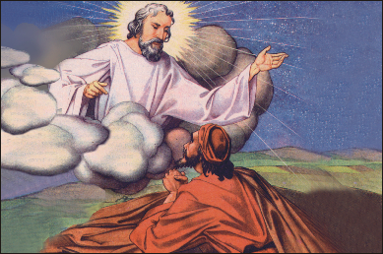
LESSON 2
THE CALL OF ABRAHAM

Slide 3
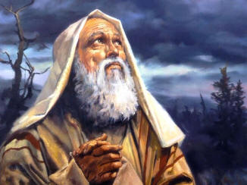
Abraham is a person with a special place in God’s plan of salvation.
The history of Abraham is found in book of Genesis the first book of bible.
He was born in the 19th century B.C in a place called Ur in Southern Mesopotamia.
B efore the call his name was Abram. He belonged to the tribe of nomads , keeping herds of cattle , moving, roaming from place to place in search of fresh pastures.
They had no permanent home anywhere . Eventually the family of Abraham came and lived in a place called Haran.

Slide 4
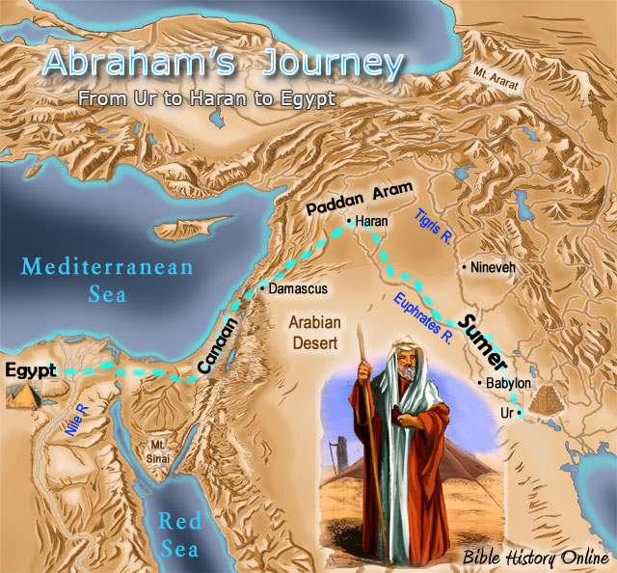
GOD CALLS
While in Haran God called Abraham and told “Go from your country and your kindred and your father’s house to the land that I will show you . I will make of you a great nation and I will bless you and make your name great, so that you will be a blessing .I will bless those who you , and curse one who curses you and in you all the families shall be blessed.”
Abram left Haran as God directed him and at that time he was 75 years old. He reached Shechem in the land of Canaan up to oak tree of Moreh.
There Lord appeared and said “ I will give this land to your offspring's ”
Abram built a altar , offered sacrifice to the Lord. And continued his journey, wherever he camped built altars and offered sacrifices.

Slide 5
THE COVENANT OF GOD
When Abram was 99 years old ,the Lord appeared to him and said “ I am God almighty; walk before me and be blameless. And I will make you exceedingly numerous. As for me this is my covenant with you : You shall be the ancestor of multitude nations. Nor shall your name be Abram , but your name shall be Abraham ; for I have made you the ancestor of multitude nations. I will make you exceedingly fruitful ; and I will make nations of you and kings shall come from you. I will establish my covenant between me and you , and your offspring after you throughout their generations, for an everlasting covenant, to be God to you and to your offspring after you. And I will give to you and your offspring after you , the land where you are now an alien, all land of Canaan for a perpetual holding ; And I will be their God.”
Thus God established a covenant with Abraham.
The name Abraham means ‘the father of great people’.

Slide 6
THE PROMISES OF GOD
Abraham shall be father of many nations
Abraham and his descendants shall have special relationship with God
Abraham and his descendants shall inherit the whole land of Canaan

Slide 7
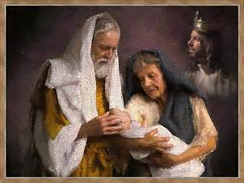
THE BIRTH OF ISAAC
God told Abraham: “ As for Sarai your wife , you shall not call her name Sarai but Sarah shall be her name. And I will bless her and also give you a son by her; then I will bless her and she shall be the mother of nations ; kings of peoples shall be from her. Sarah your wife shall bear you a son and you shall name him Isaac ; I will establish with him for an everlasting covenant , and with his descendants ever after him.”
While Abraham was camping in valley of Mamre in Canaan three angels appeared to him and told him that a son will be born for him in his wife Sarah.
According to the promise made by God Sarah conceived and bore Abraham a son and named him Isaac.

Slide 8
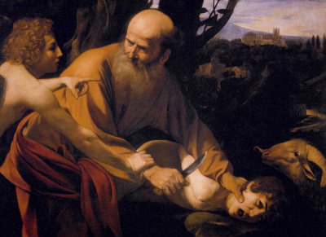
THE SACRIFICE OF ABRAHAM
Abraham obeyed God’s command ,made preparations for burnt offering and started with Isaac. On the way Isaac asked “ We have fire and the wood but where is the lamb for the burnt offering?” And Abraham replied “God himself shall provide the lamb”
Abraham reached the place which God had told him, made an altar and arranged the firewood in order. He then laid his son Isaac on the wood.
Abraham took a knife and was about to slay Isaac when angel of Lord called Abraham from heaven and said “Do not lay your hand on the lad or do anything to him, for now I know you fear God , since you have not withheld his son ,your only son from me.”
When Abraham lifted up his eyes he sa a ram caught in thicet by its horns and offered it as a burnt offfering.

Slide 9
FATHER OF NATIONS
Abraham thus passed the test of God. God was pleased with him and said “In your seed all the nations shall be blessed because you have obeyed my voice,”
Thus Abraham became the father of all those who were going to be his chosen people.

Slide 10
FATHER OF BELIEVERS
It was due to his deep faith in God that Abraham became ‘ the father of believers’
His whole life testifies his unwavering faith in God
It was through his faith in God he left the homeland and proceeded to the land of Canaan and also prepared to sacrifice his only son and God was pleased with his obedience.
He stood firm in his faith and proved it through actions. That is how he became father of believers.
We also may come across with occasions when our faith will be tested. Even then we must be able to prove our deep-rooted faith in God through our words and deeds. This is the lesson we learn from the life of Abraham.

Slide 11
Let us pray
Taste and see how good the Lord is. Blessed is he who trusts in Him.

Slide 12
READ AND RECOUNT
Describe how Abraham got ready to sacrifice isaac (Gen.22:1-18)

Slide 13

WORD OF GOD FOR GUIDANCE
Abraham believed in the Lord, and He reckoned
It to him for righteousness (Gen.15:6)

Slide 14
MY DECISION
Like Abtaham, I will trust in god and obey His Commandments.

Slide 15
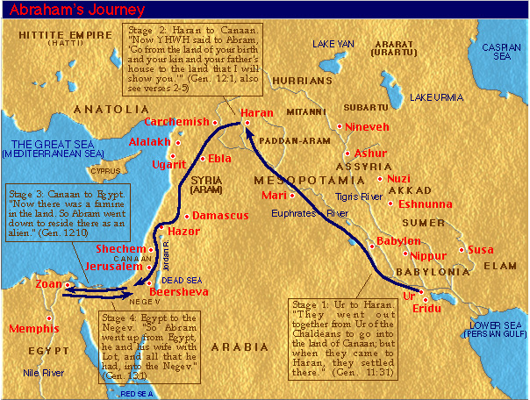
LET US DO
Mark the following places in the map: Ur and Haran

Slide 16
LET US FIND OUT THE ANSWER
1. What is the meaning of the name Abraham?
2. What are the promises God gave to Abraham through His covenant with him?
3. What did God ask Abraham to do in order to test his faith?
4. How did Abraham become the father of all believers?
5. What is the lesson we learn from the life of Abraham?

Slide 17
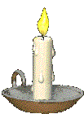


Thank you

